Slide 1
A Convolutional Neural Network Cascade for Face Detection
201912056 Noh Sujin

Slide 2
INDEX
1. Purpose of the study
2. Course of study
3. Experiments
4. conclusion

Slide 3
The difficulties in face detection mainly come from two aspects
1. Purpose of the study
1. the large visual variations of human faces in the cluttered backgrounds 2. the large search space of possible face positions and face sizes
The boosted cascade
In the past, the most popular and effective design for practical face detection. However, due to the simple nature of the Haar feature, it is relatively weak in the uncontrolled environment where faces are in varied poses, expressions under unexpected lighting.
Therefore, this paper proposes a cascade architecture built on convolutional neural networks (CNNs) with very powerful discriminative capability, while maintaining high performance to address problems.

Slide 4
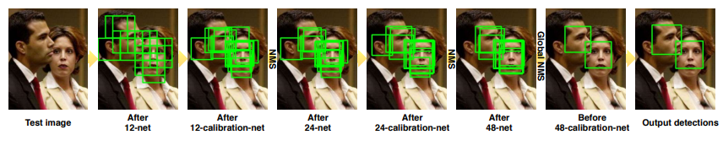
2. Course of study
This study introduces a CNN-based calibration stage after each of the detection stages in the cascade.
Test pipeline of our detector

Slide 5
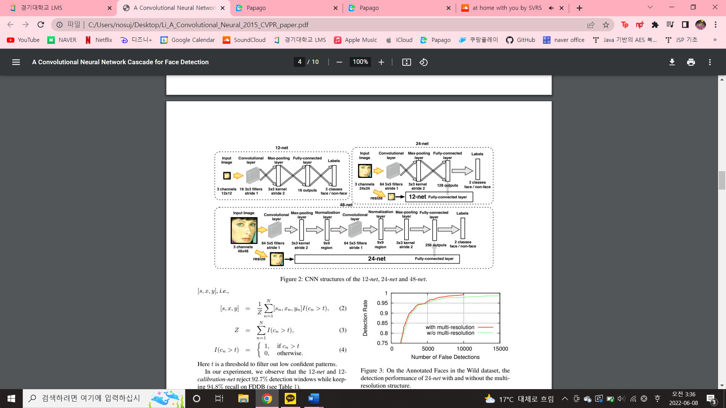
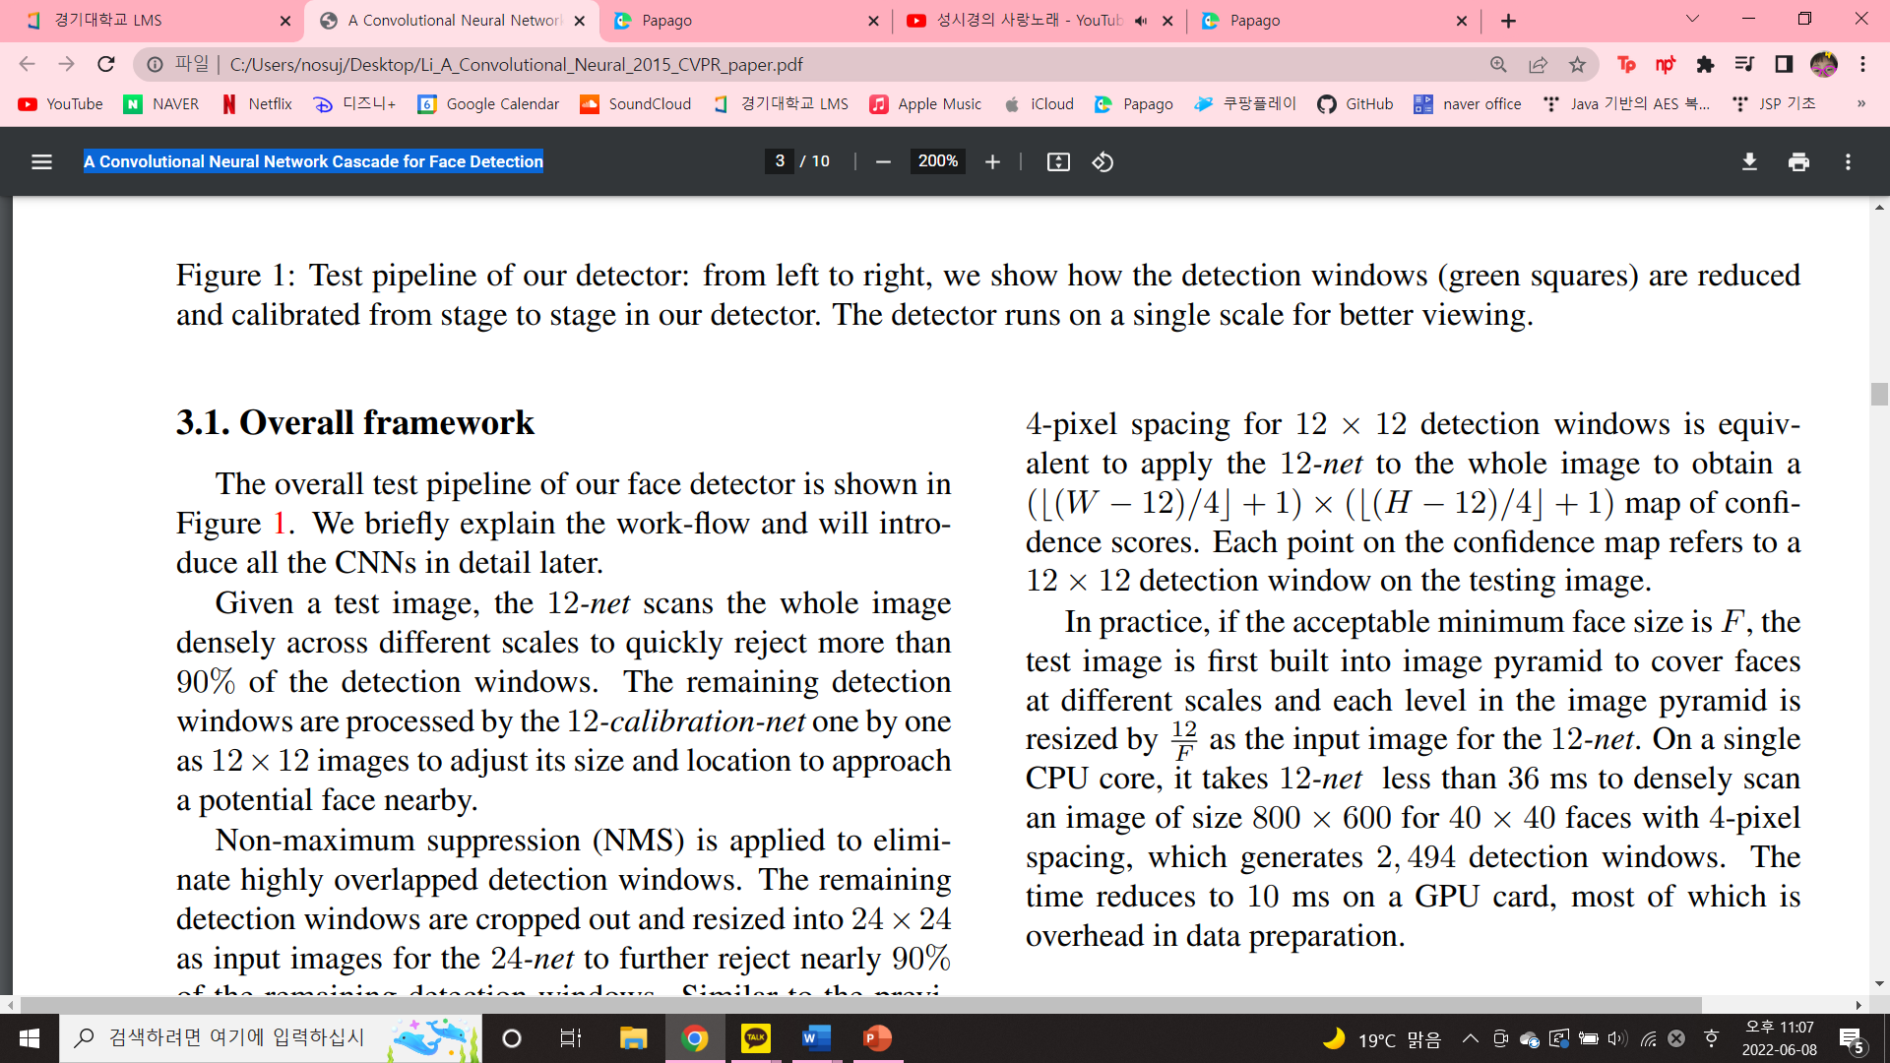
2. Course of study
1) 12-net
A very shallow binary classification CNN to quickly scan the testing image.
Densely scanning an image of size W × H with 4-pixel spacing for 12 × 12 detection windows is equivalent to apply the 12-net to the whole image to obtain a map of confidence scores.
Each point on the confidence map refers to a 12 × 12 detection window on the testing image.

Slide 6
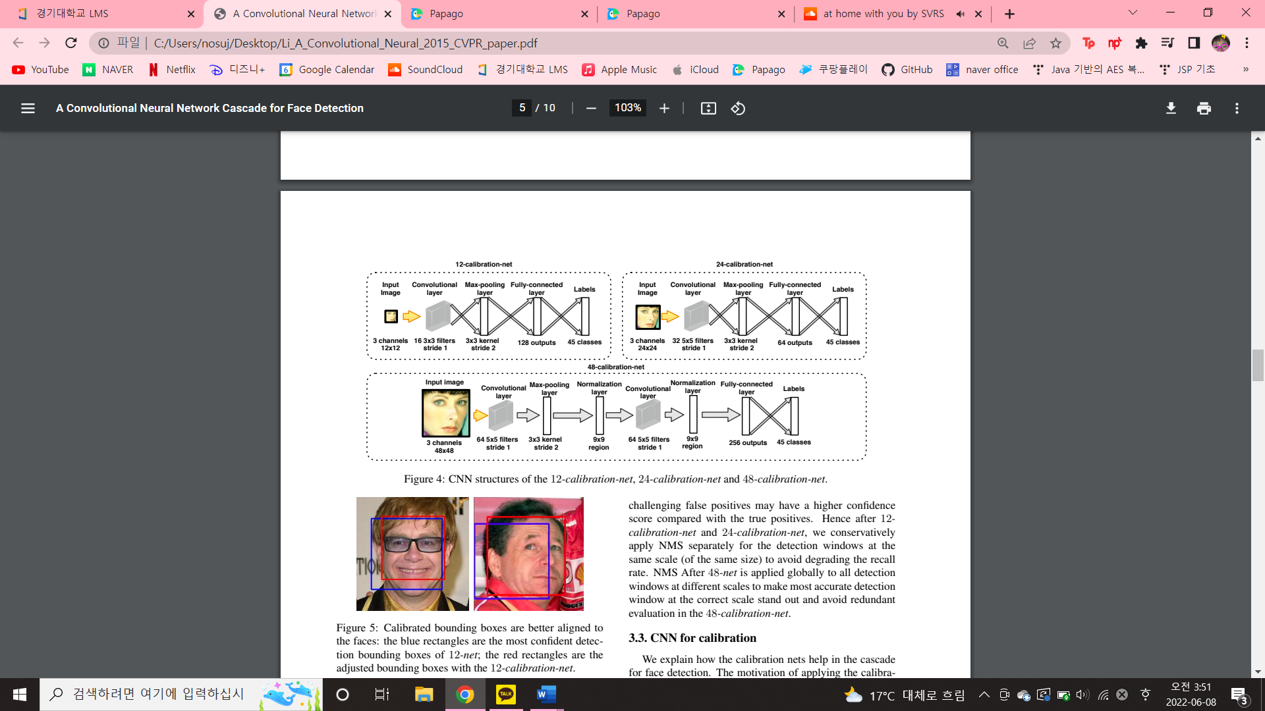
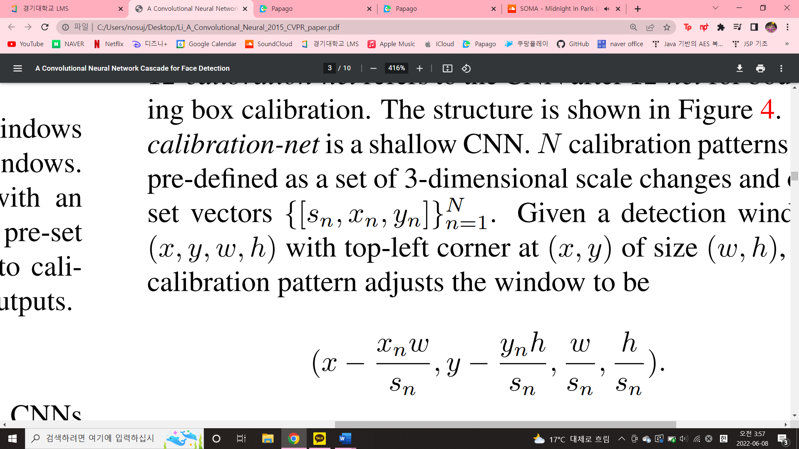
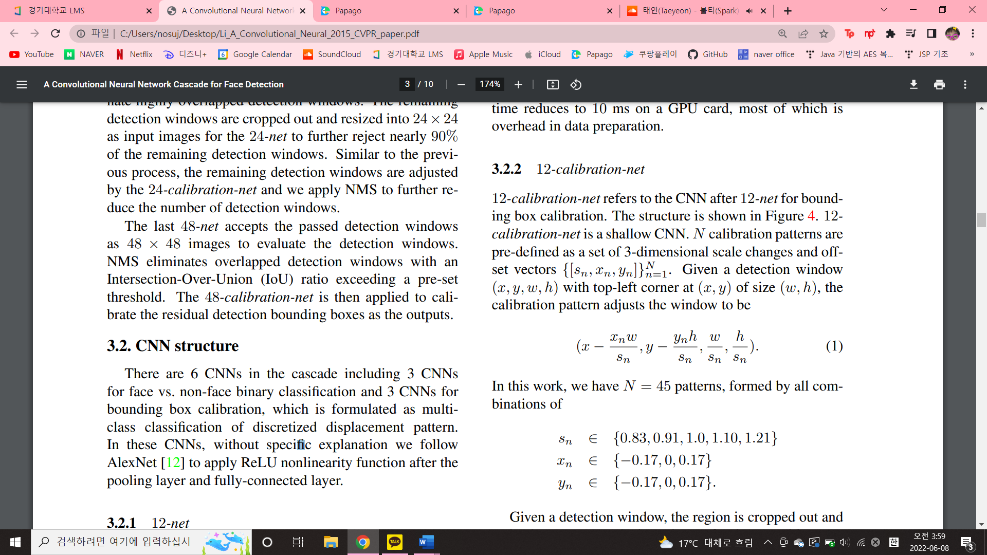
2. Course of study
2) 12-calibration-net
a shallow CNN after 12-net for bounding box calibration.
N calibration patterns are pre-defined as a set of 3-dimensional scale changes and off-set vectors
Given a detection window (x, y, w, h) with top-left corner at (x, y) of size (w, h), the calibration pattern adjusts the window to be
this work have N = 45 patterns, formed by all combinations of Sn ∈ {0.83, 0.91, 1.0, 1.10, 1.21} Xn ∈ {−0.17, 0, 0.17} Yn ∈ {−0.17, 0, 0.17}.

Slide 7
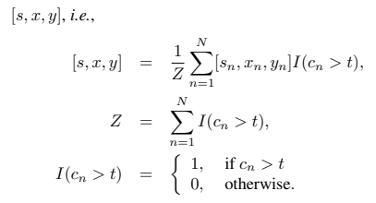
2. Course of study
2) 12-calibration-net
Given a detection window, the region is cropped out and resized to 12×12 as the input image for the 12-calibrationnet.
The calibration net outputs a vector of confidence scores [c1, c2, · · · , cN ]
Since the calibration patterns are not orthogonal to each other, we take the average results of the patterns of high confidence score as the adjustment
Here t is a threshold to filter out low confident patterns.

Slide 8
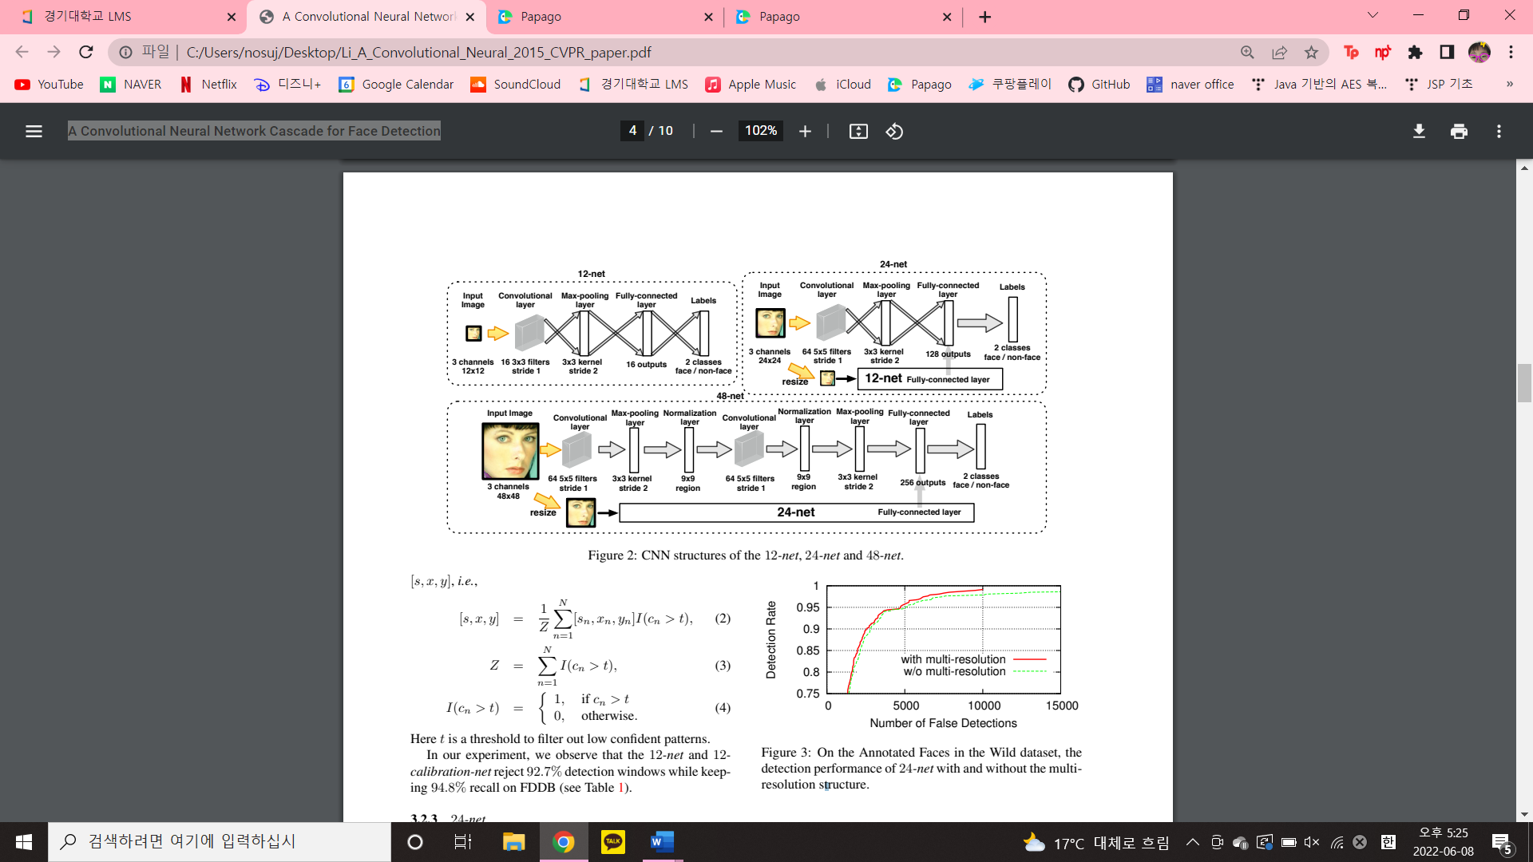
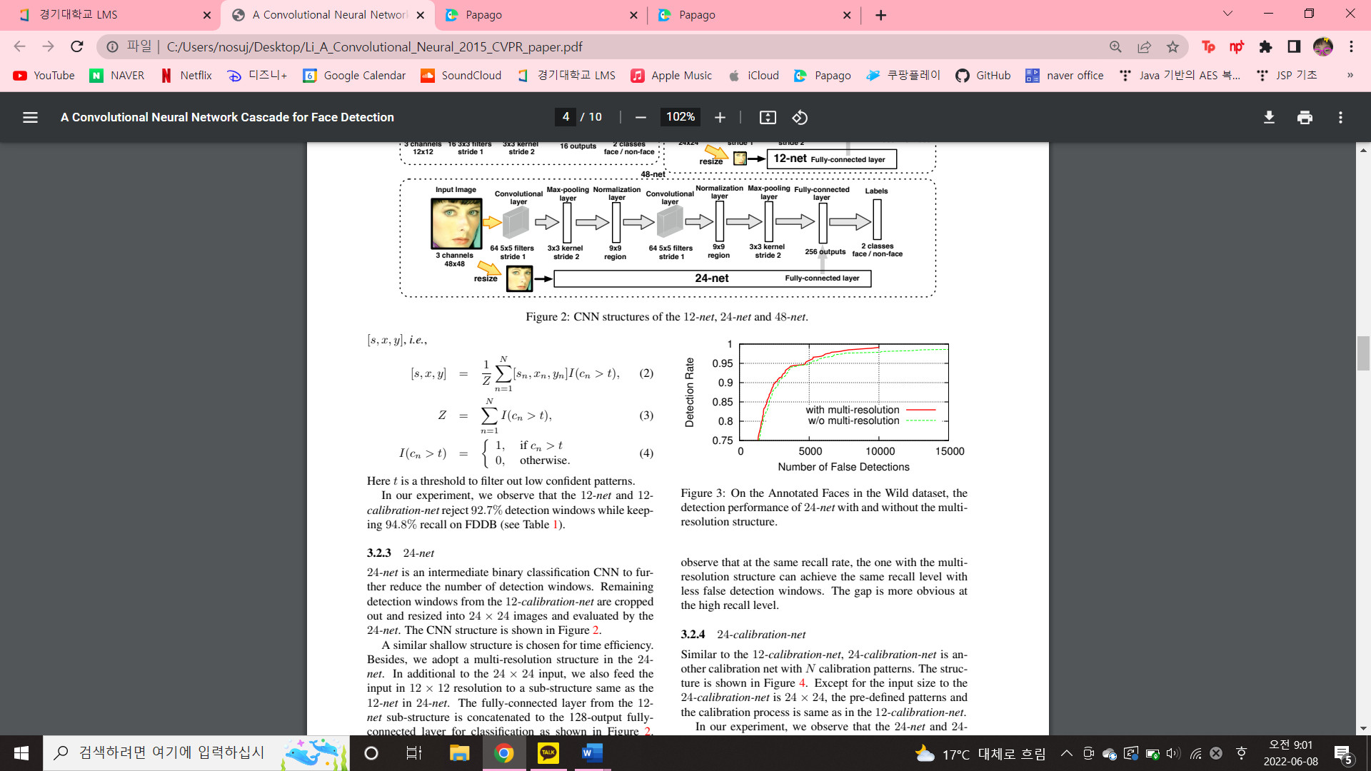
2. Course of study
3) 24-net
An intermediate binary classification CNN to further reduce the number of detection windows.
Remaining detection windows from the 12-calibration-net are cropped out and resized into 24 x 24 images and evaluated by the 24-net.
A similar shallow structure is chosen for time efficiency.
multi-resolution structure

Slide 9
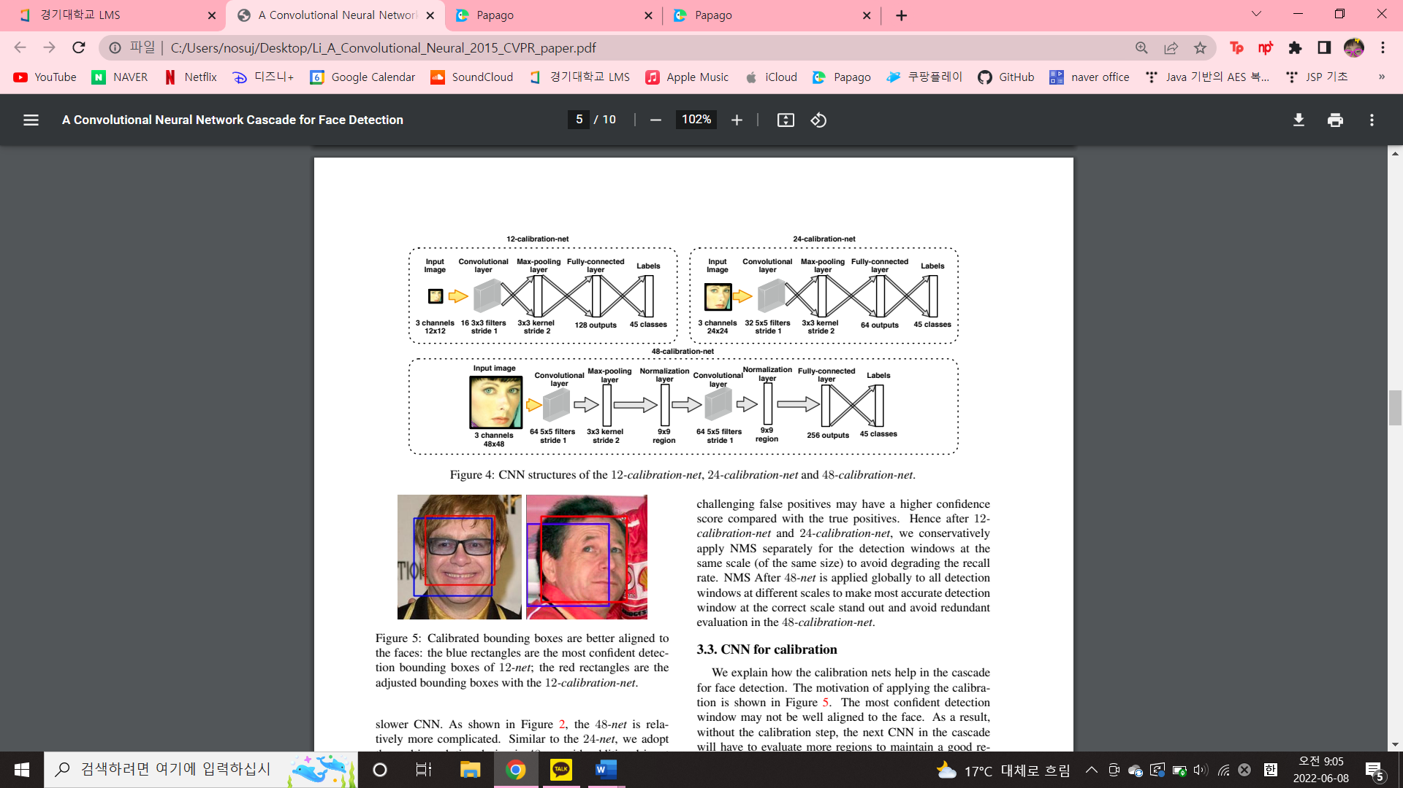
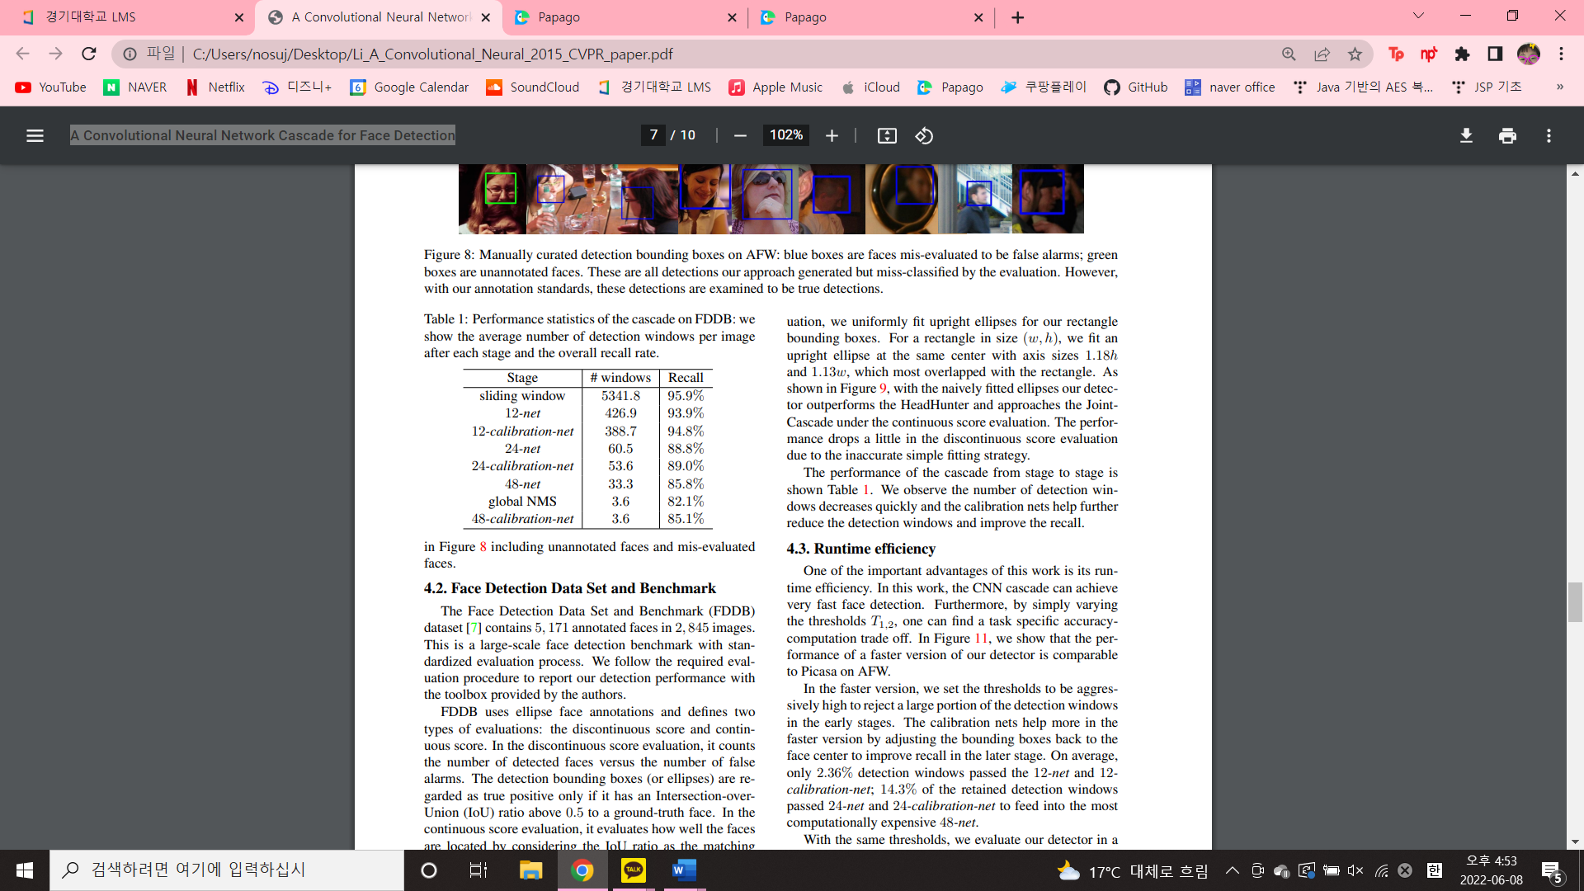
2. Course of study
4) 24-calibration-net
- The predefined patterns and the calibration process is same as in the 12-calibration-net, Except for the input size to the 24-calibration-net is 24 x 24.

Slide 10
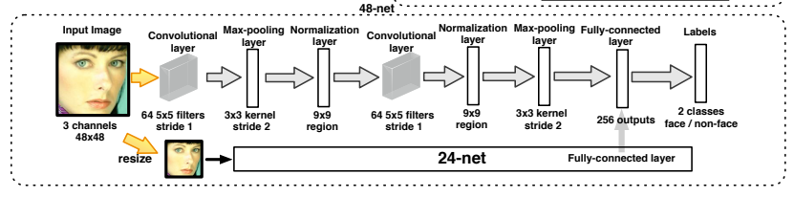
2. Course of study
5) 48-net
The last binary classification CNN and relatively more complicated.
Similar to the 24-net, we adopt the multi-resolution design in 48-net with additional input copy in 24 x 24 and a substructure the same as the 24-net.

Slide 11
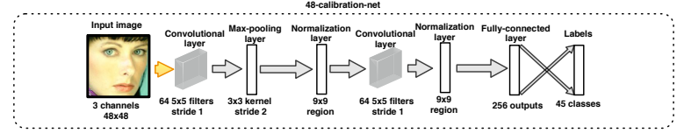
2. Course of study
6) 48-calibration-net
The last stage in the cascade
The same N = 45 calibration patterns are pre-defined for the 48-calibration-net. We use only one pooling layer in this CNN to have more accurate calibration.

Slide 12
2. Course of study
Non-Maximum Suppression (NMS)
This paper adopts an efficient implementation of the NMS in this work.
We iteratively select the detection window with the highest confidence score and eliminate the detection windows with an IoU ratio higher than a preset threshold to the selected detection window.
After 12- calibration-net and 24-calibration-net, we conservatively apply NMS separately for the detection windows at the same scale (of the same size) to avoid degrading the recall rate.
NMS After 48-net is applied globally to all detection windows at different scales to make most accurate detection window at the correct scale stand out and avoid redundant evaluation in the 48-calibration-net.

Slide 13
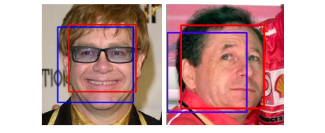
2. Course of study
CNN for calibration
The motivation of applying the calibration is
As a result, without the calibration step, the next CNN in the cascade will have to evaluate more regions to maintain a good recall. The overall detection runtime increases significantly.
To address this problem, we train a multi-class classification CNN for calibration.
As shown above figure, after calibration the detection bounding box is better aligned to the real face center.

Slide 14
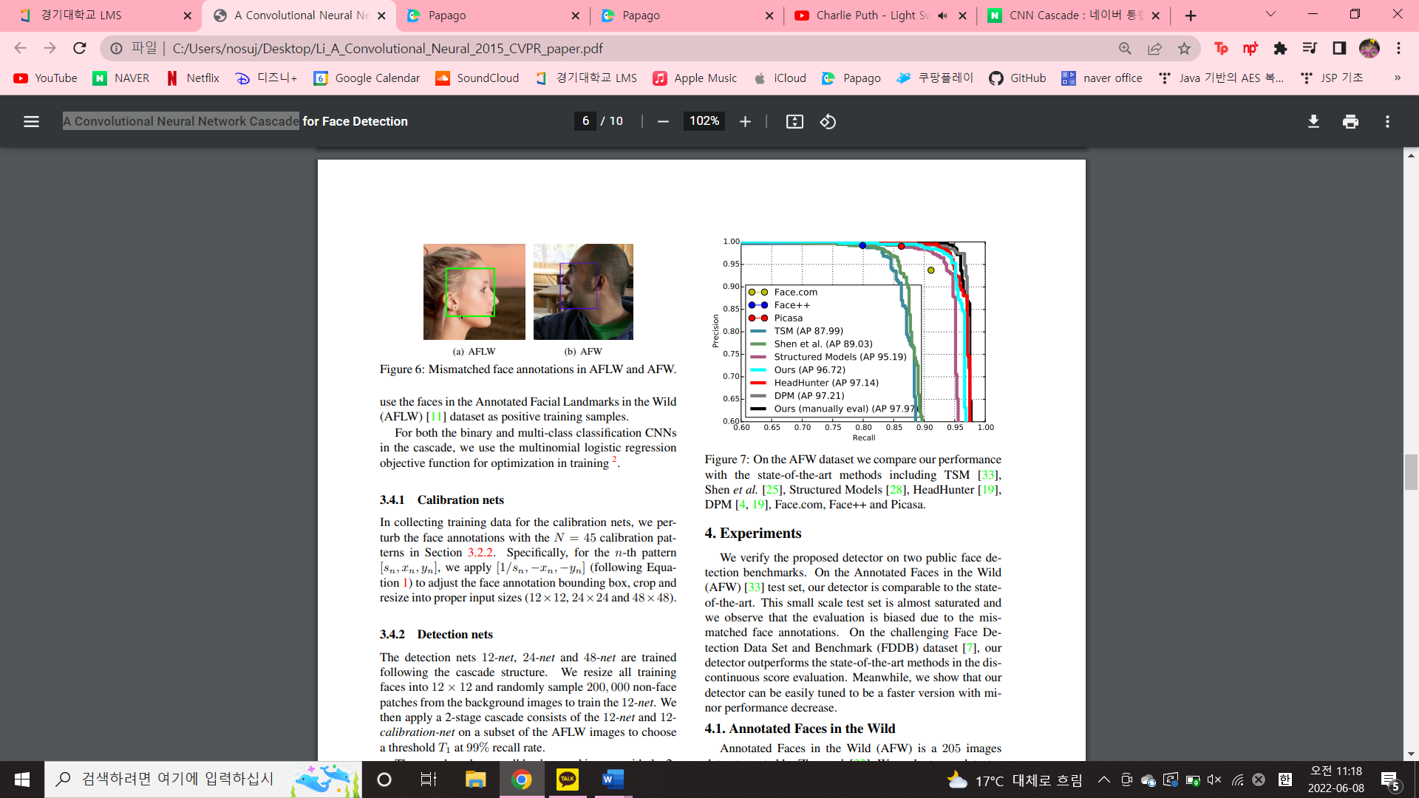
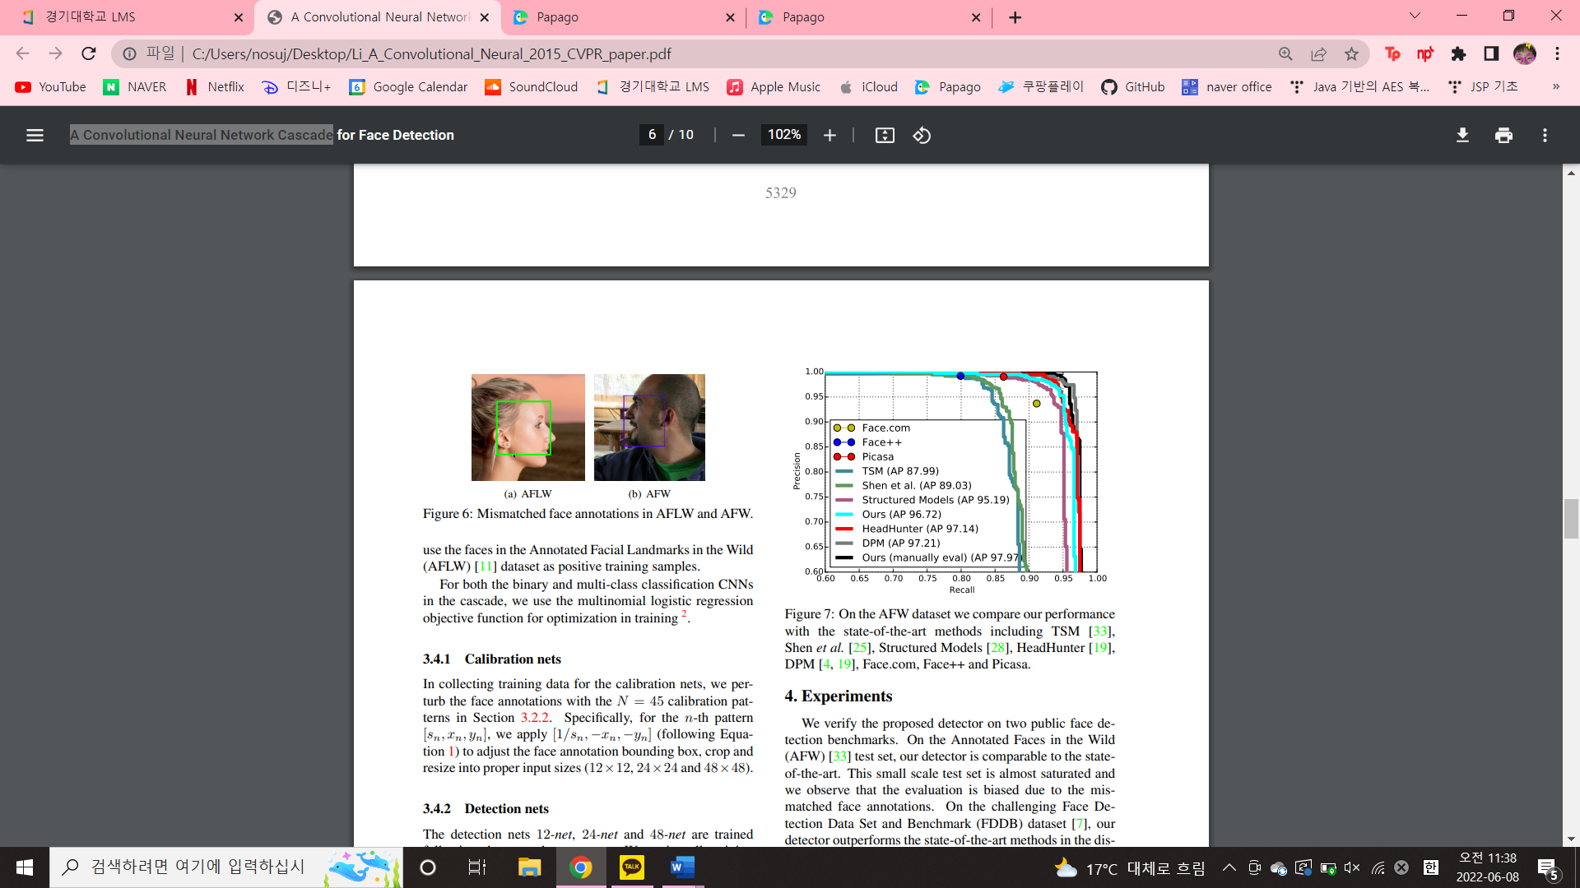
3. Experiments
Annotated Faces in the Wild
Annotated Faces in the Wild (AFW) is a 205 images dataset. We evaluate our detector on AFW
As shown below Figure, the annotations in AFLW and AFW are mismatched.

Slide 15
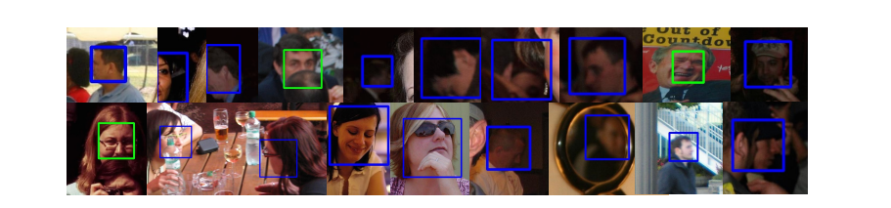
3. Experiments
Annotated Faces in the Wild
In the evaluation on AFW, we follow the remedial method proposed by Mathias to search for a global rigid transformation of the detection outputs to maximize the overlapping ratio with the ground-truth annotations with the shared evaluation tool.
However, our annotations cannot be simply linearly mapped to AFW annotations, after the global transformation step the mismatches still exist.
Therefore, we manually evaluate the output detections and get better results.

Slide 16
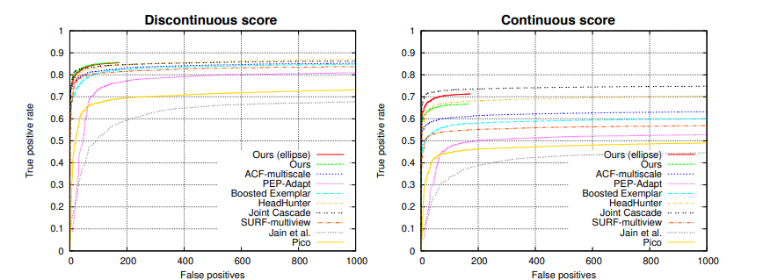
3. Experiments
Face Detection Data Set and Benchmark
The Face Detection Data Set and Benchmark (FDDB) dataset contains 5,171 annotated faces in 2,845 images. - FDDB uses ellipse face annotations and defines two types of evaluations: the discontinuous score and continuous score.
We uniformly extend our square detection bounding boxes vertically by 20% to be upright rectangles on FDDB to better approach their ellipse annotation.

Slide 17
3. Experiments
Face Detection Data Set and Benchmark
<The performance of the cascade from stage to stage>
We observe the number of detection windows decreases quickly and the calibration nets help further reduce the detection windows and improve the recall.

Slide 18
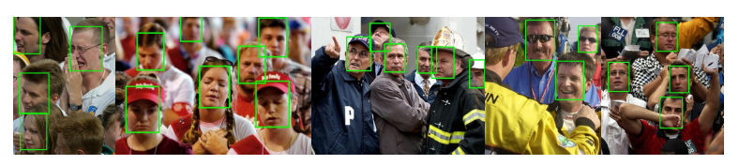
4. Conclusion
In this work, we present a CNN cascade for fast face detection.
Calibration nets are introduced in the cascade to accelerate detection and improve bounding box quality.

